Slide 1
Agenda Install VS Studio Install Anaconda Interlink VS Code with Anaconda env

Slide 2
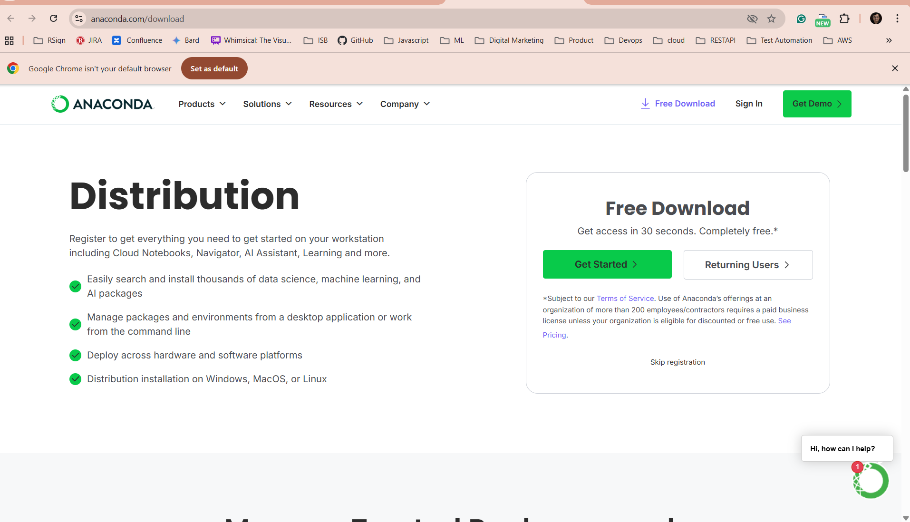
Anaconda is a distribution of Python (and R). To use Python in VS Code, you only need to have the Python interpreter installed on your system. Installing Anaconda is not required. However, the Anaconda installer simplifies package and environment management. It sets up Python, preinstalls many libraries, and configures several tools to streamline Python development, especially for data science and scientific computing tasks

Slide 3
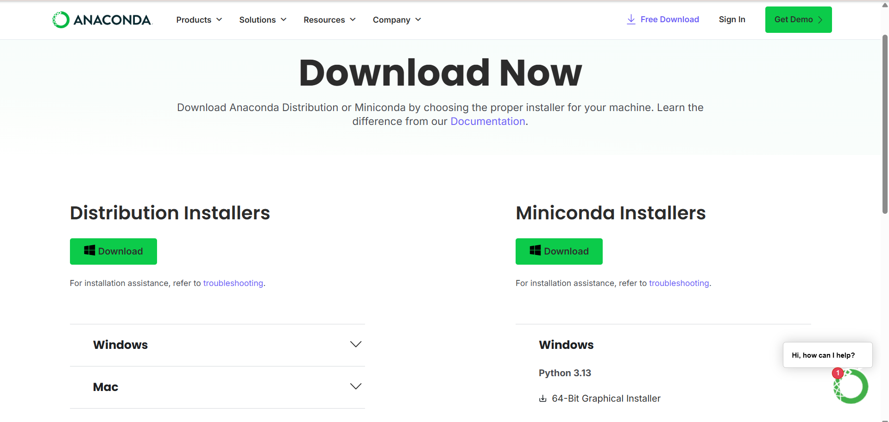
Download Miniconda
Click Here.

Slide 4
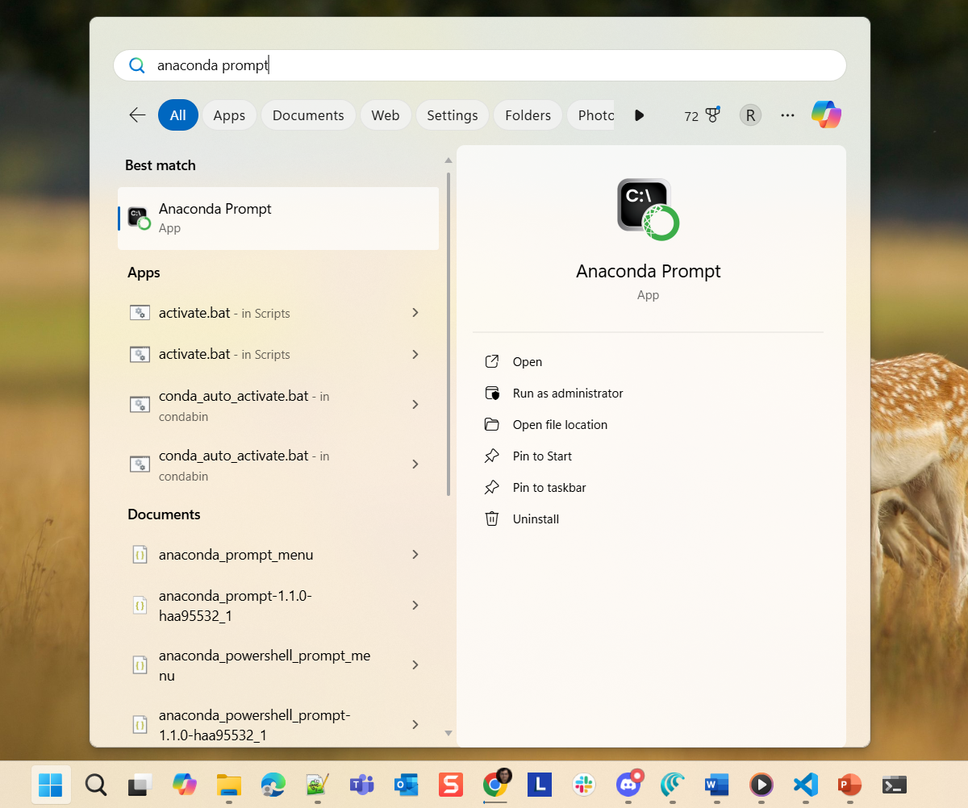
Search for Anaconda Prompt in your Windows or MAC machine
Pin it to the taskbar & open it

Slide 5
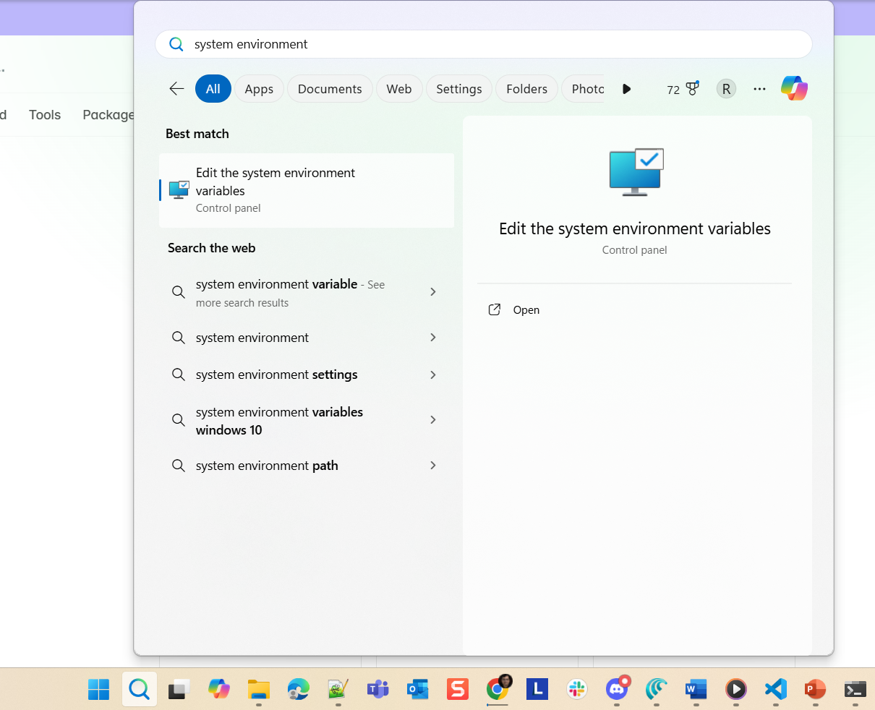
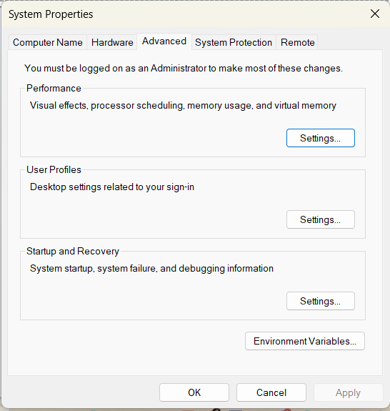
Pin it to the taskbar & open it

Slide 6
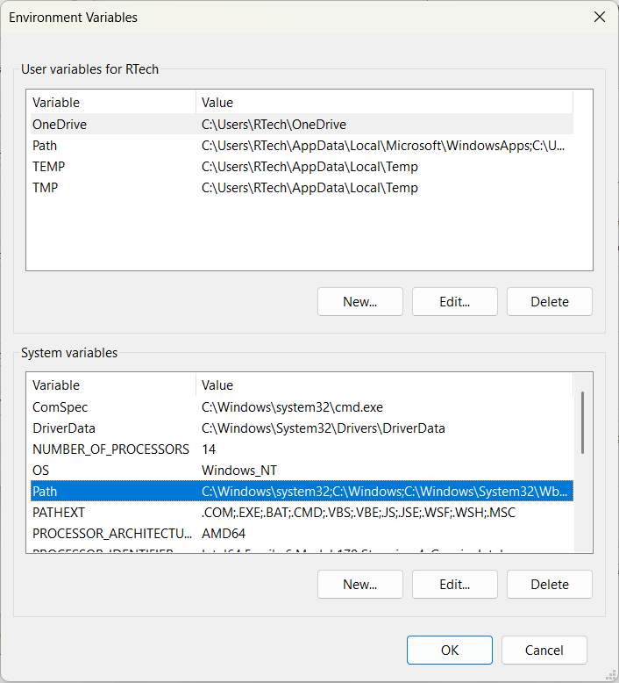
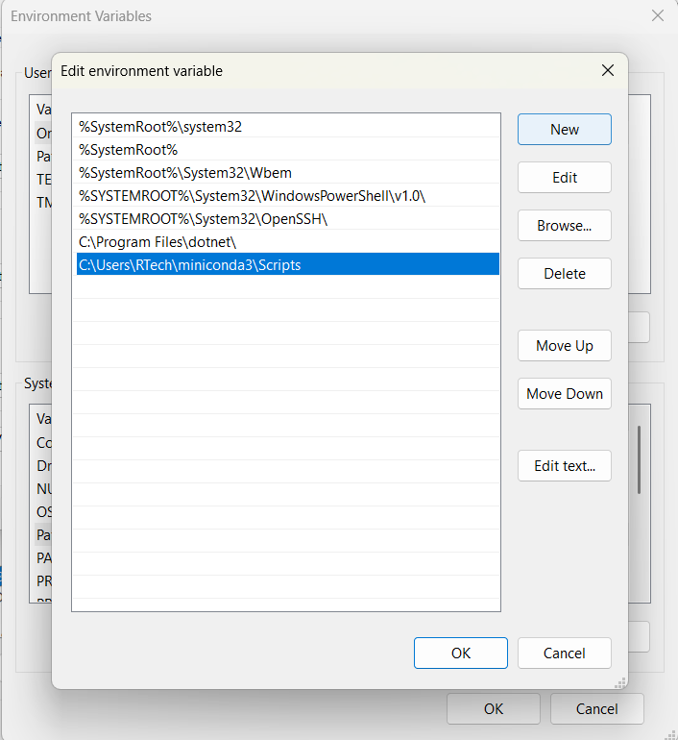
Replace this with your username.

Slide 7
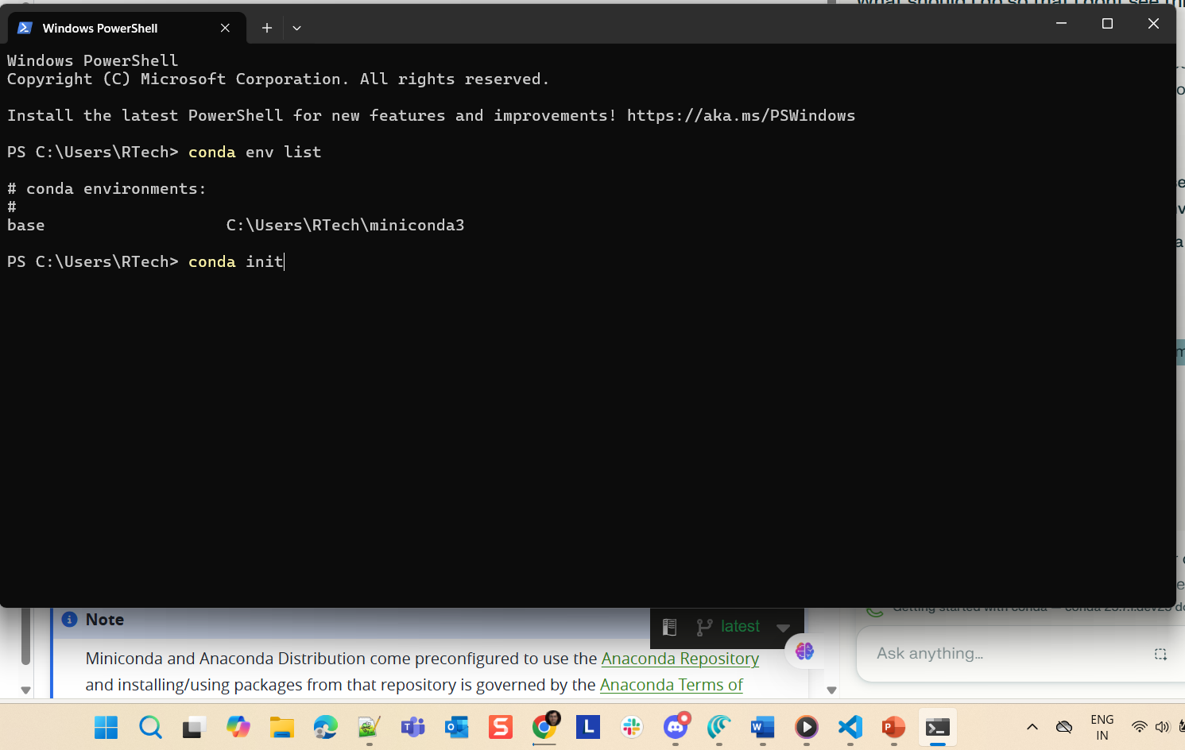
initialise conda in your shell environment before using the conda activate command from VS Code editor. This ensures the shell is configured correctly to use conda environments..
1. Click here to open Anaconda prompt

Slide 8
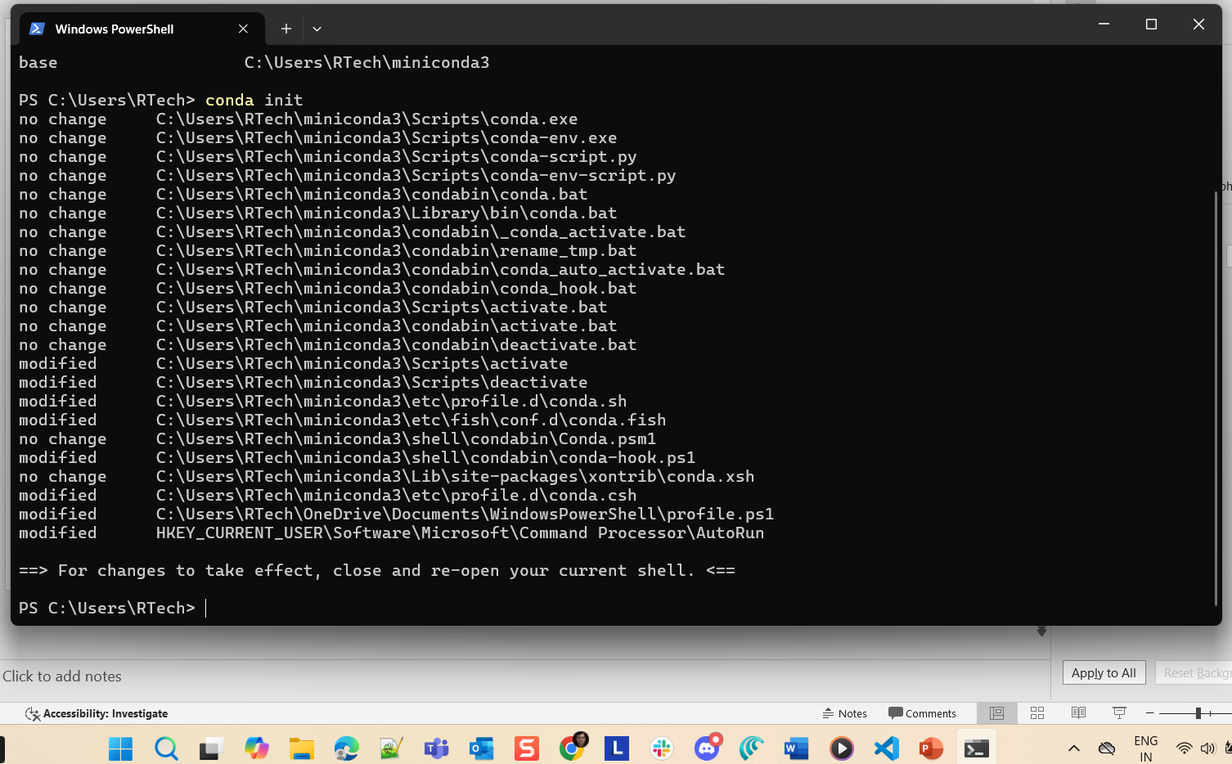
Now restart your shell, VS Code, or run the Python file again.

Slide 9
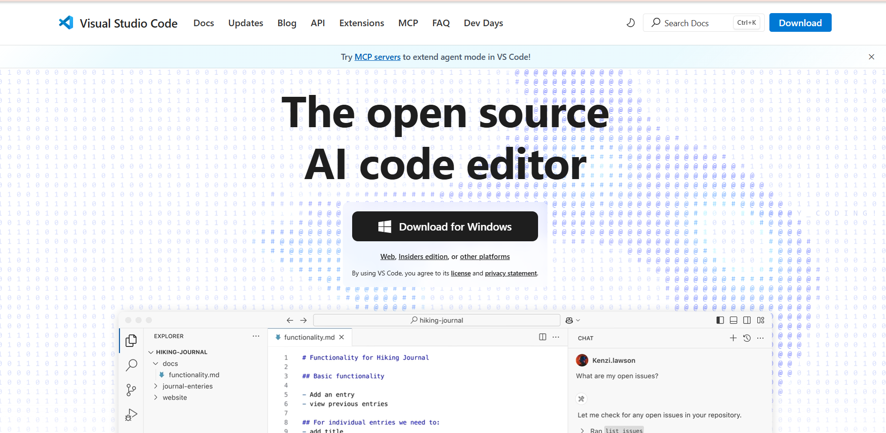
1. Go to https://code.visualstudio.com/
Click here to download

Slide 10
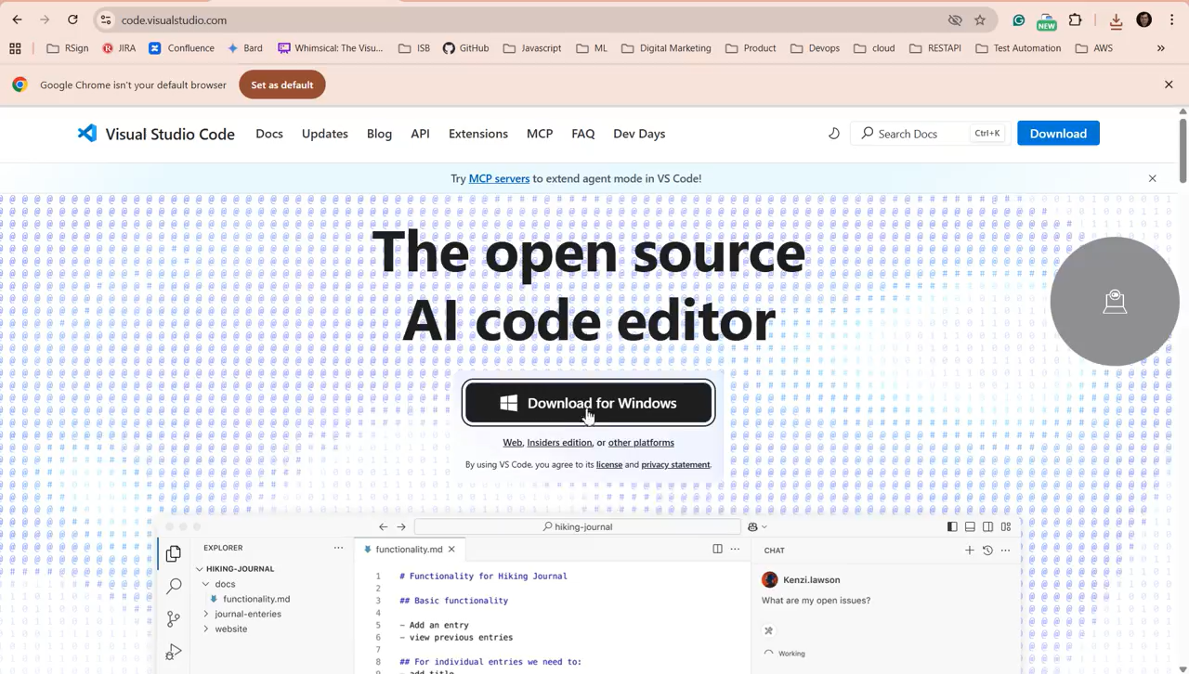
2. Install VS Code Editor

Slide 11
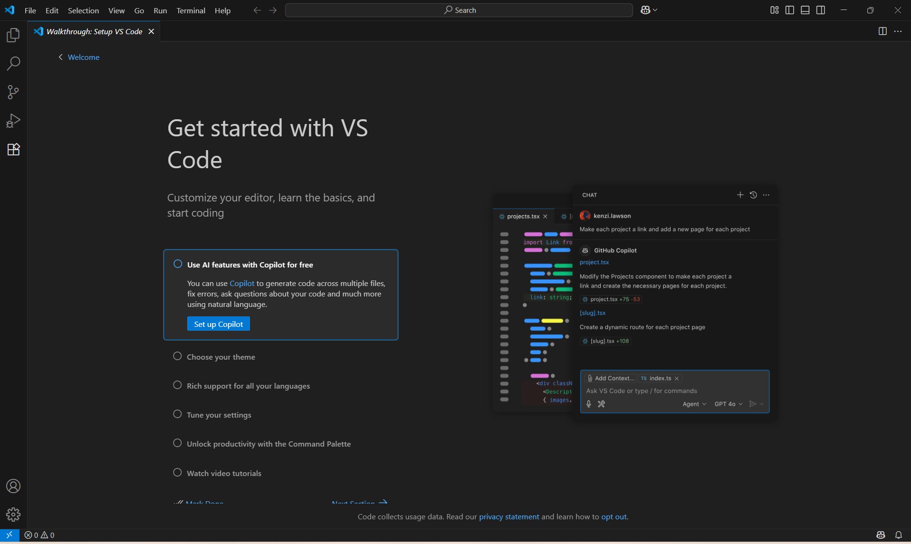
3. Install VS Code Editor
You can use VSCode for any programming language. Let’s install the extension for Python by clicking this link.

Slide 12
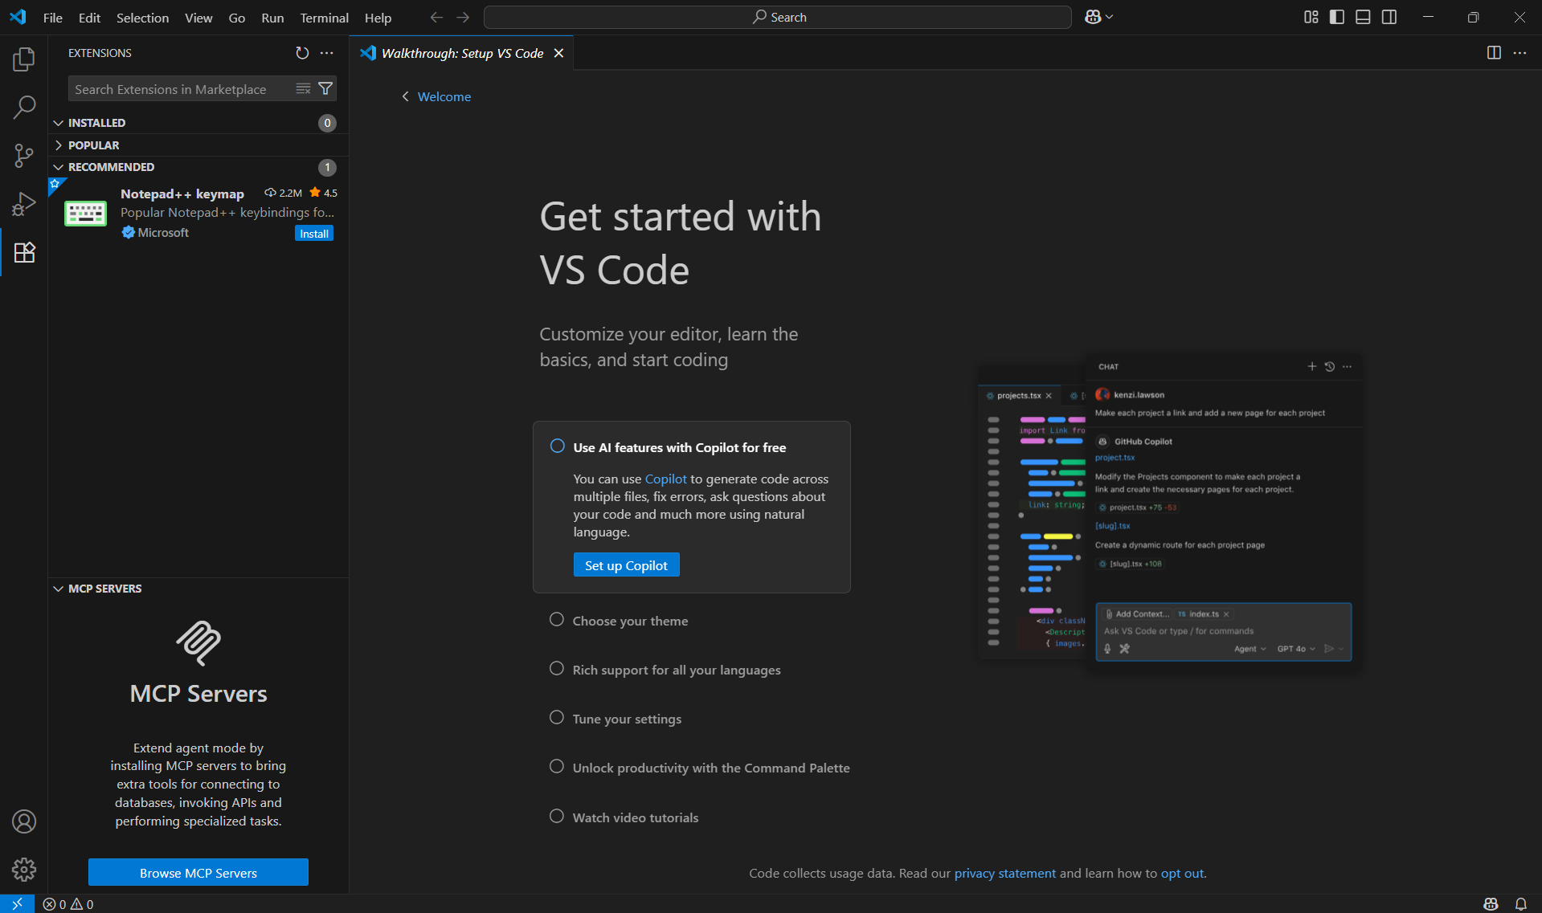
3. Install VS Code Editor
Type Python here

Slide 13
3. Install VS Code Editor
Type Python here

Slide 14
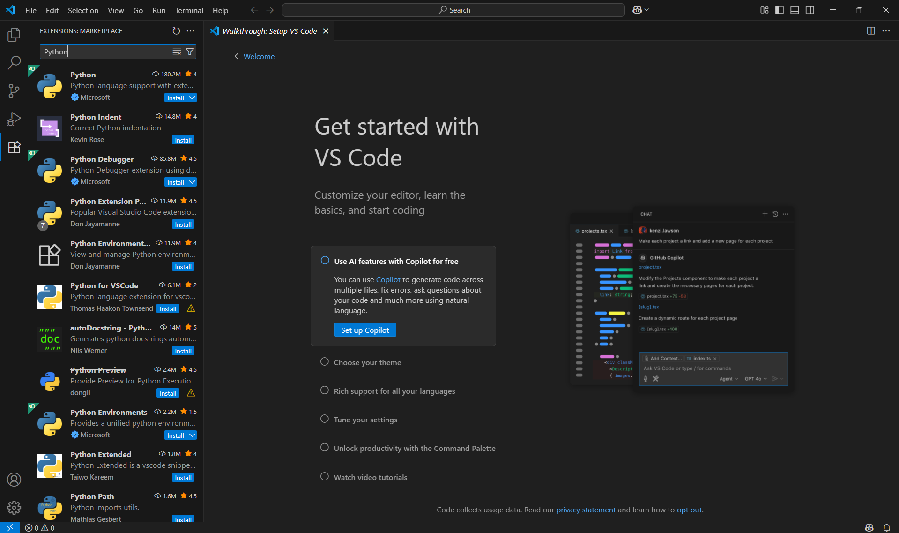
Select Microsoft's Python

Slide 15
Install Microsoft's Python. Autocompletion and colour coding is better in this version

Slide 16
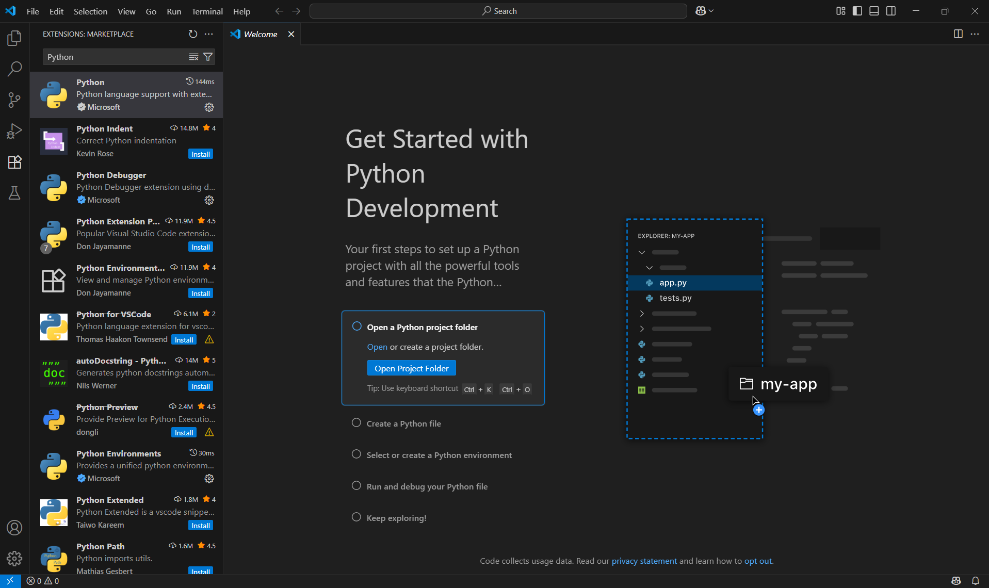
Install Microsoft's Python. Autocompletion and colour coding is better in this version
Click here after successful installation

Slide 17
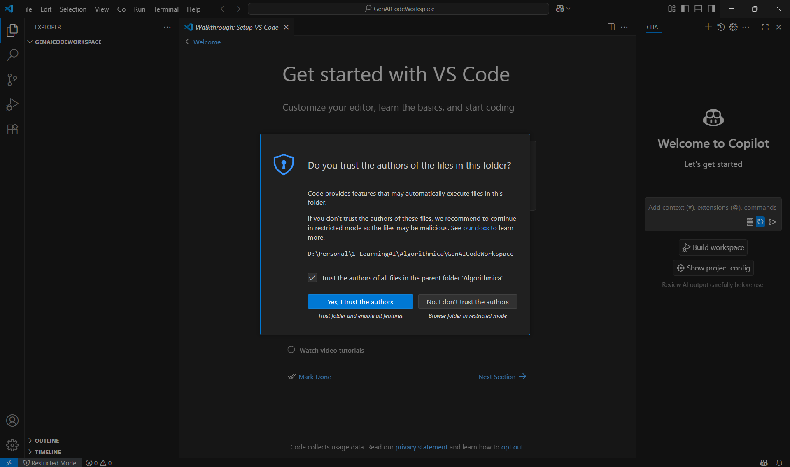
Select a folder on your file system where the code will be stored. This is your workspace.
Click here

Slide 18
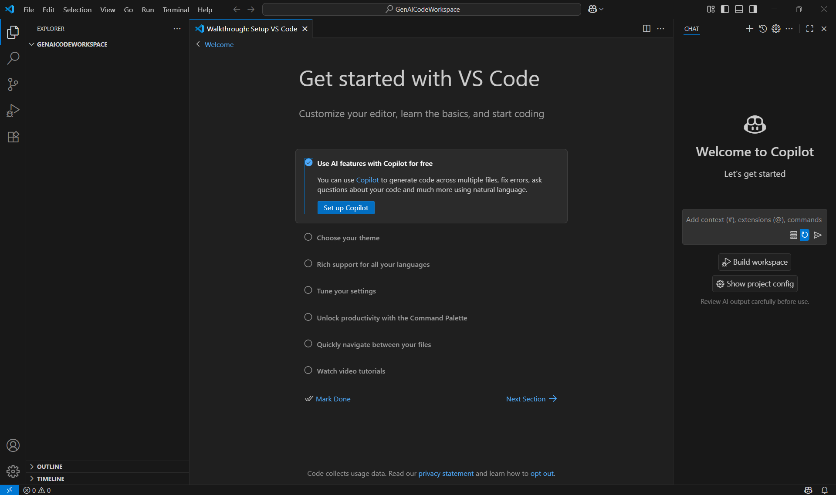
Click here to setup copolot

Slide 19
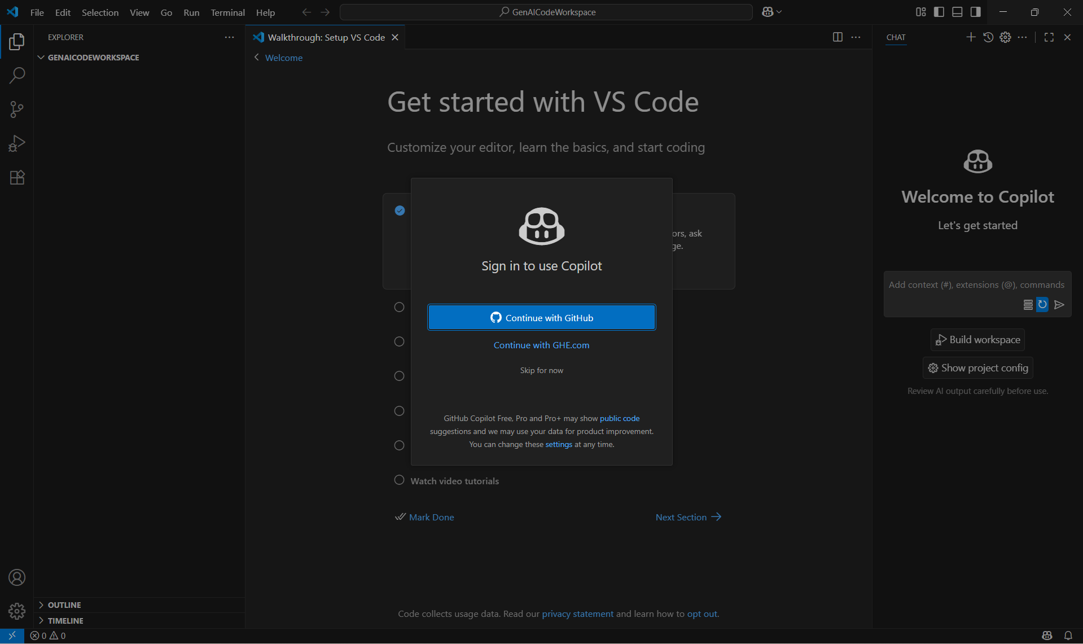
Connect with Github

Slide 20
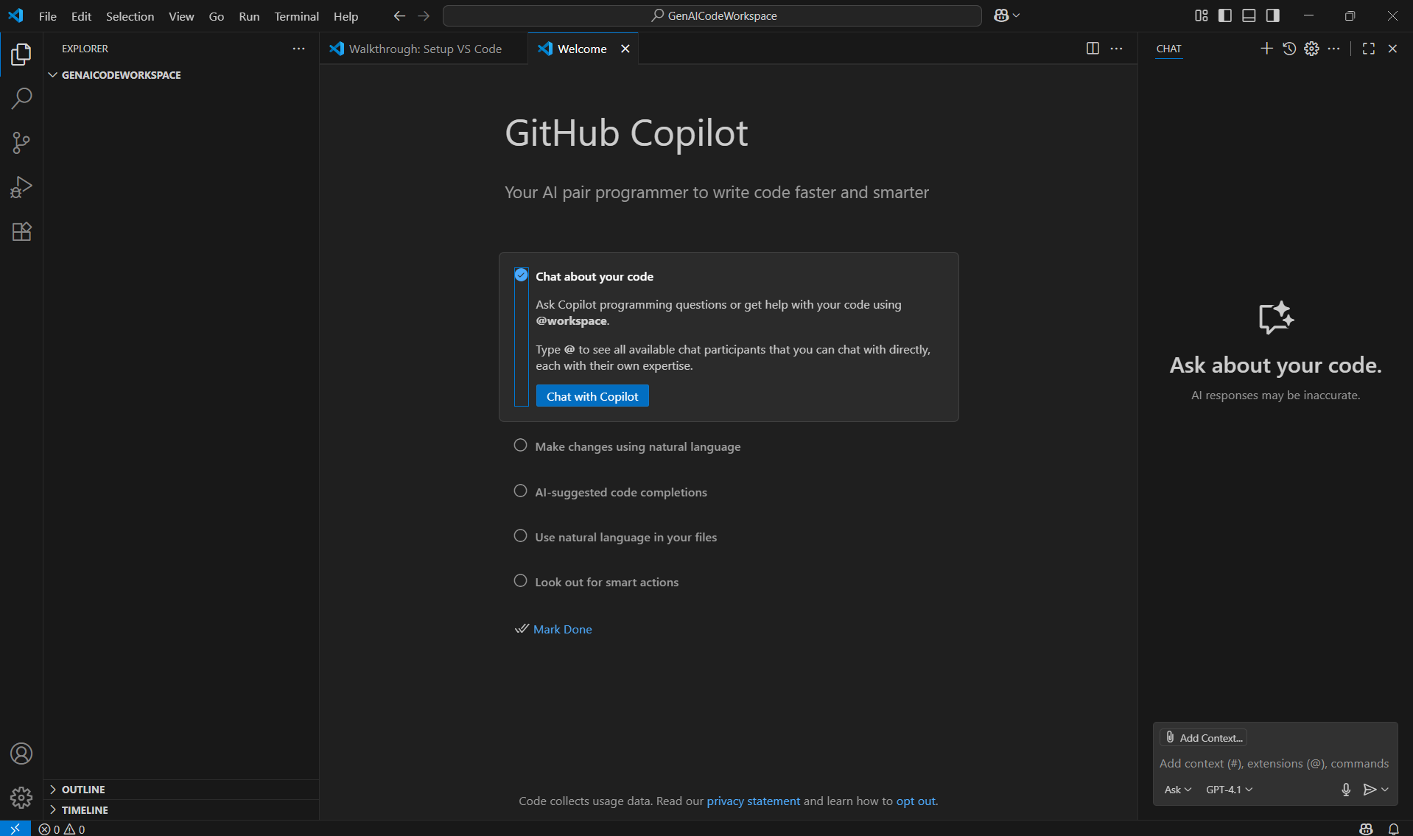
After connecting with GitHub, chat with Copilot.

Slide 21
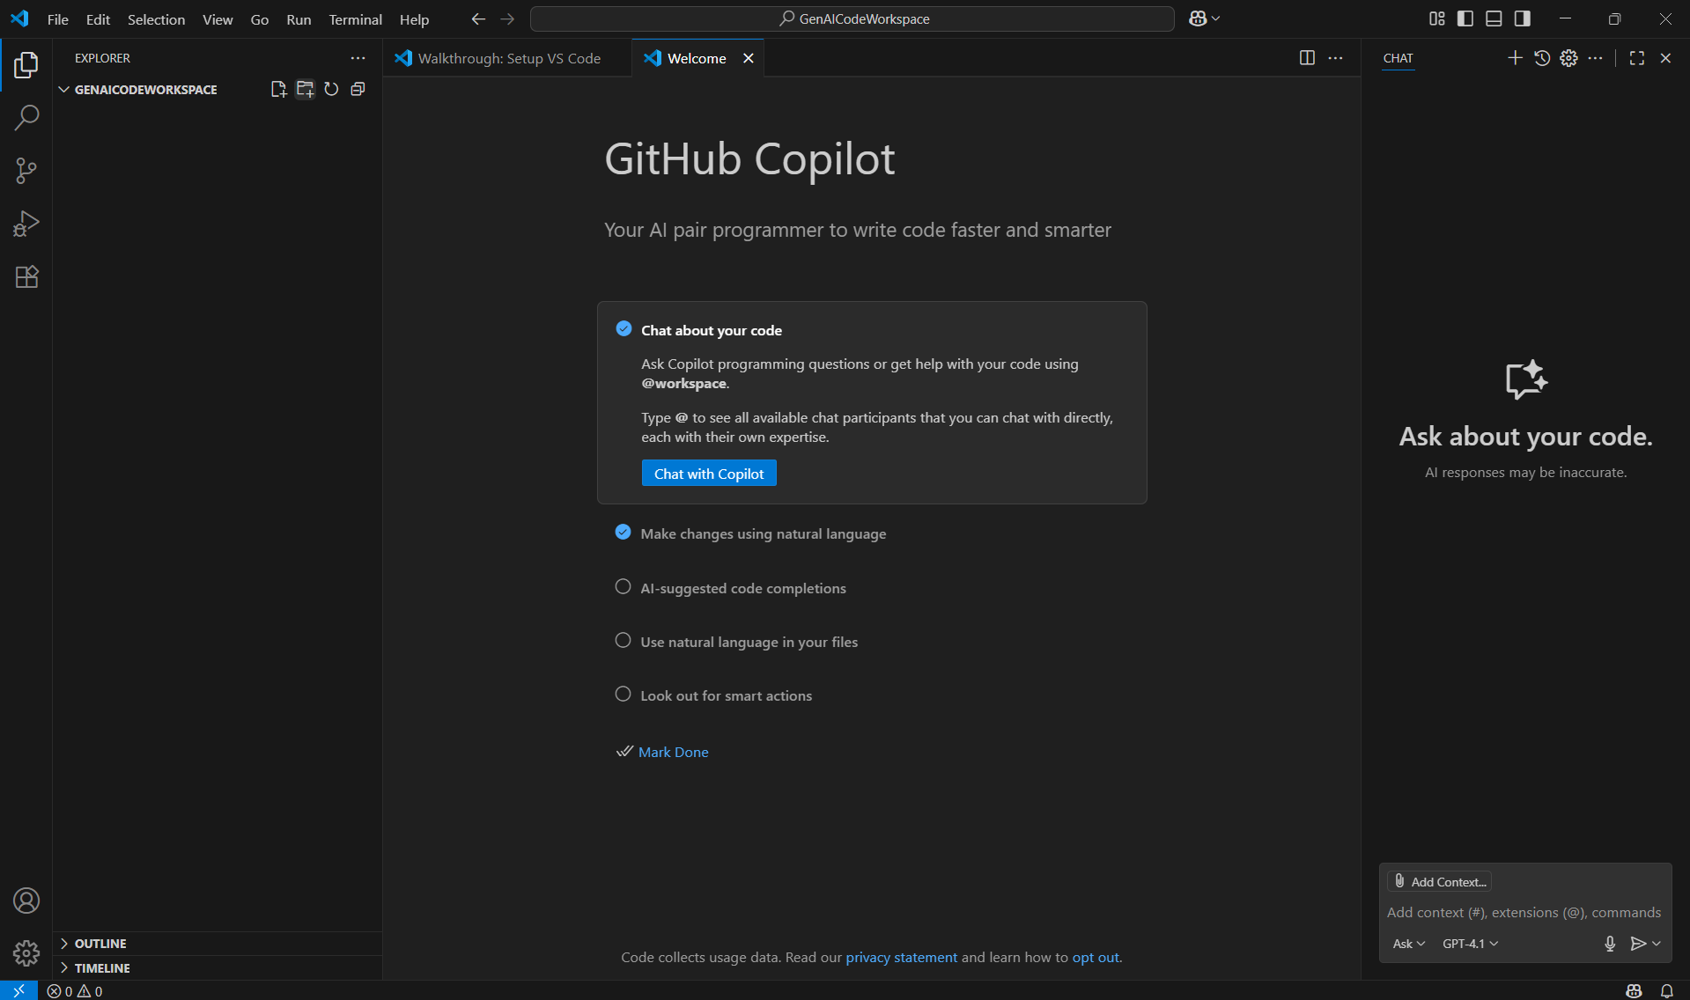
Click here to create a folder.

Slide 22
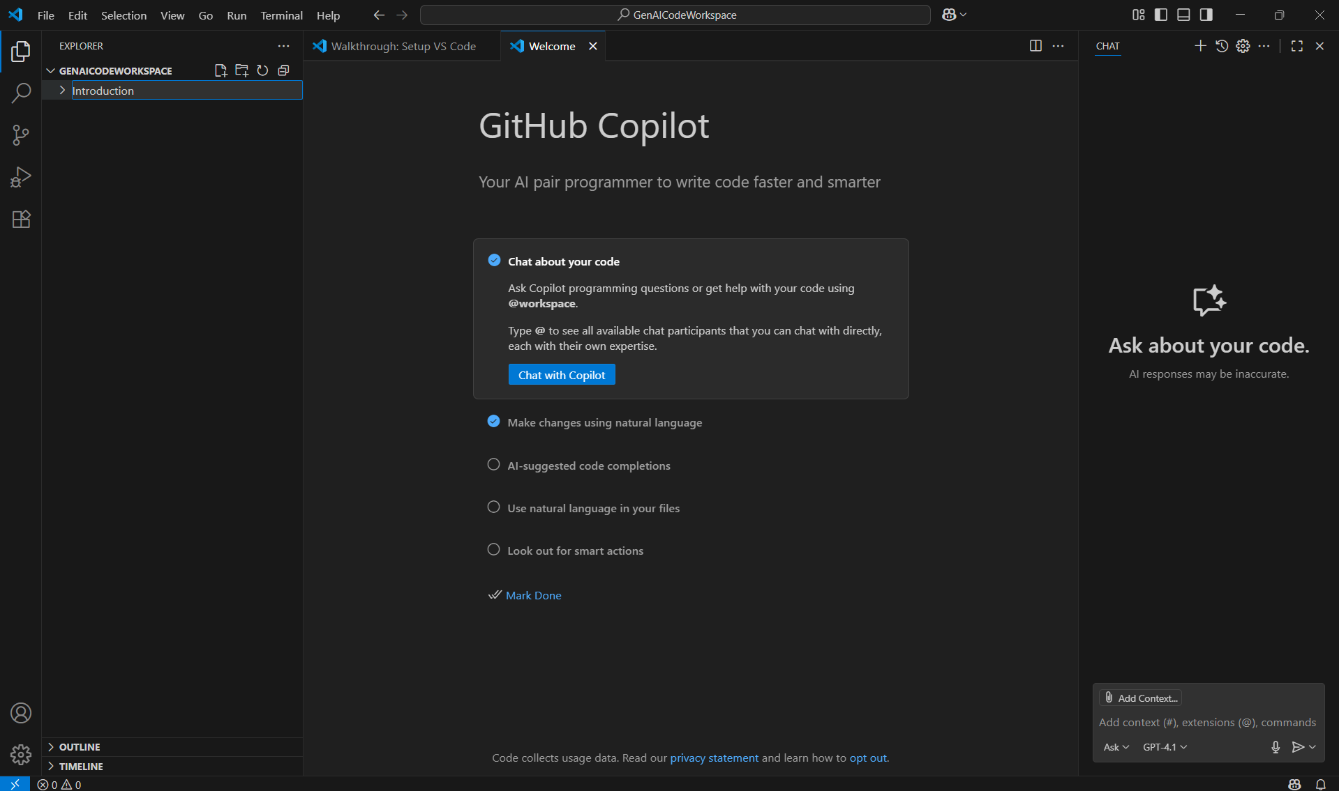
Enter the folder name

Slide 23
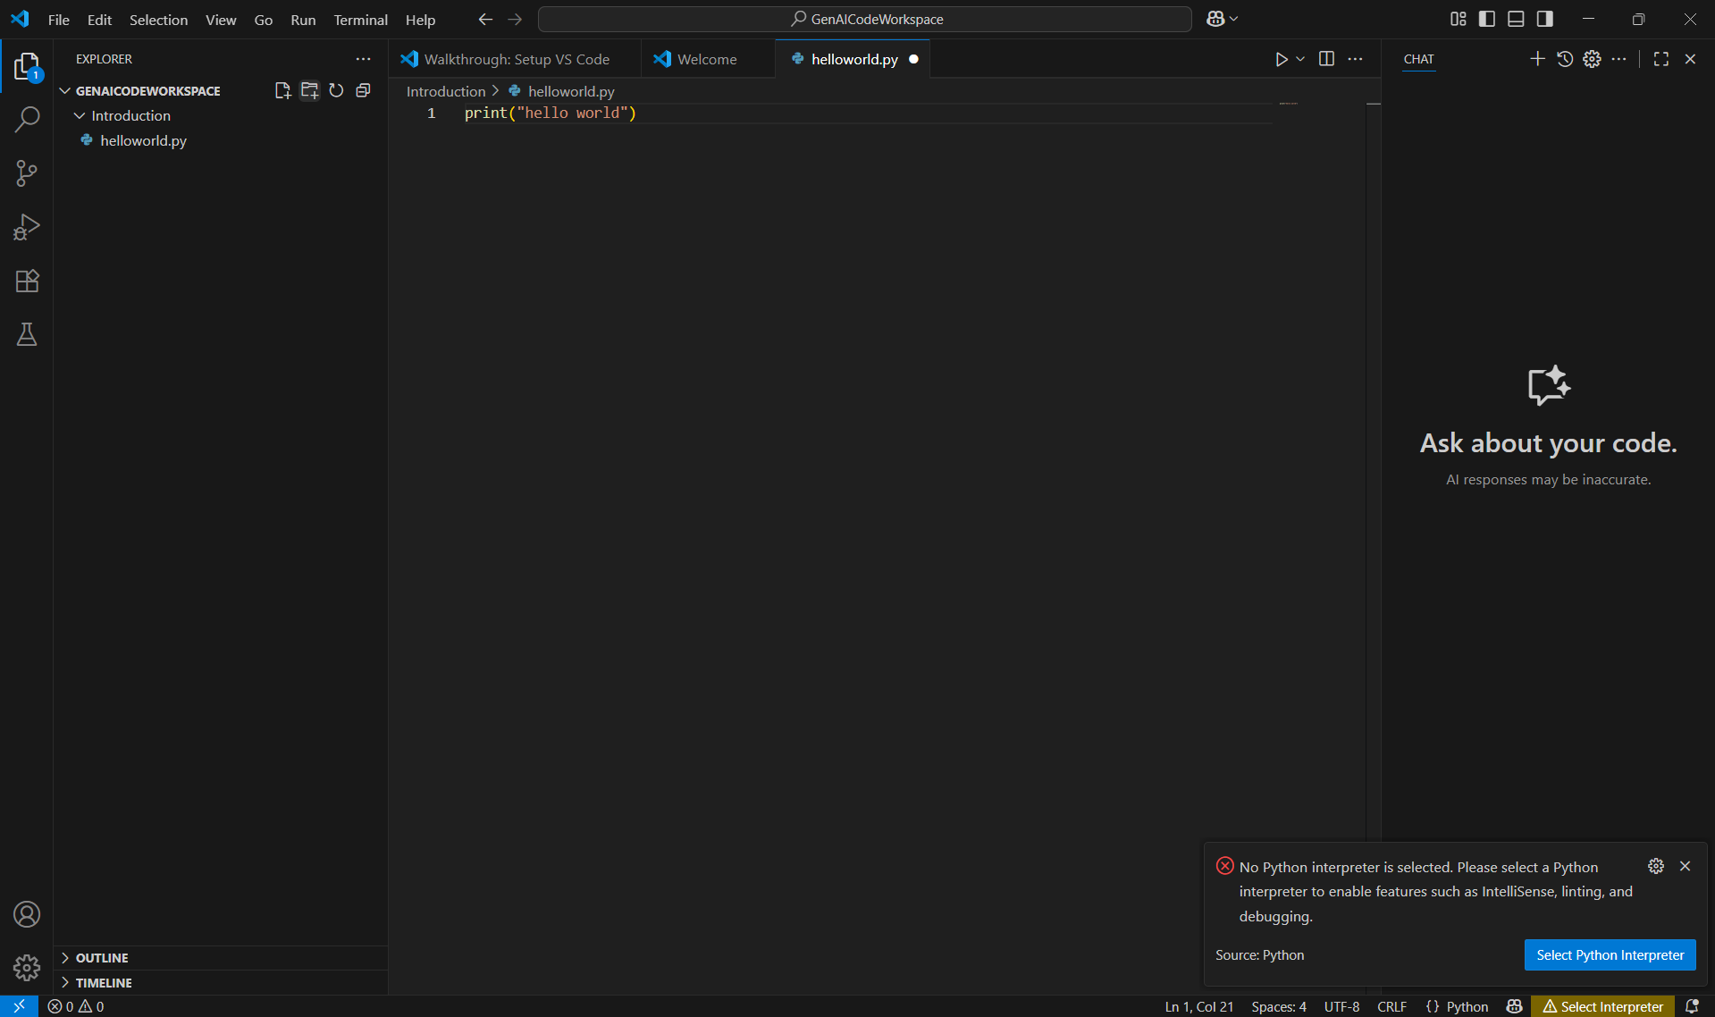
4. Click here
1. Click here to create a file
2. Enter the file name
3. Type this line to check if the installation is correct
5. VS Code doesn't know which interpreter to use to run the Python code. Click here to configure it.

Slide 24
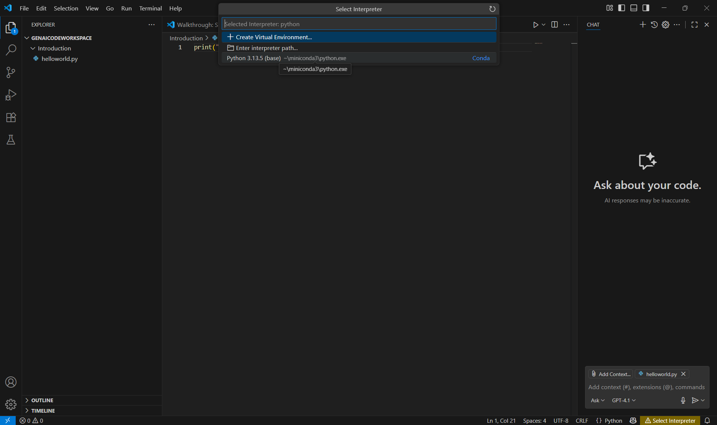
Now select the Python interpreter installed by Miniconda.
Run this file

Slide 25
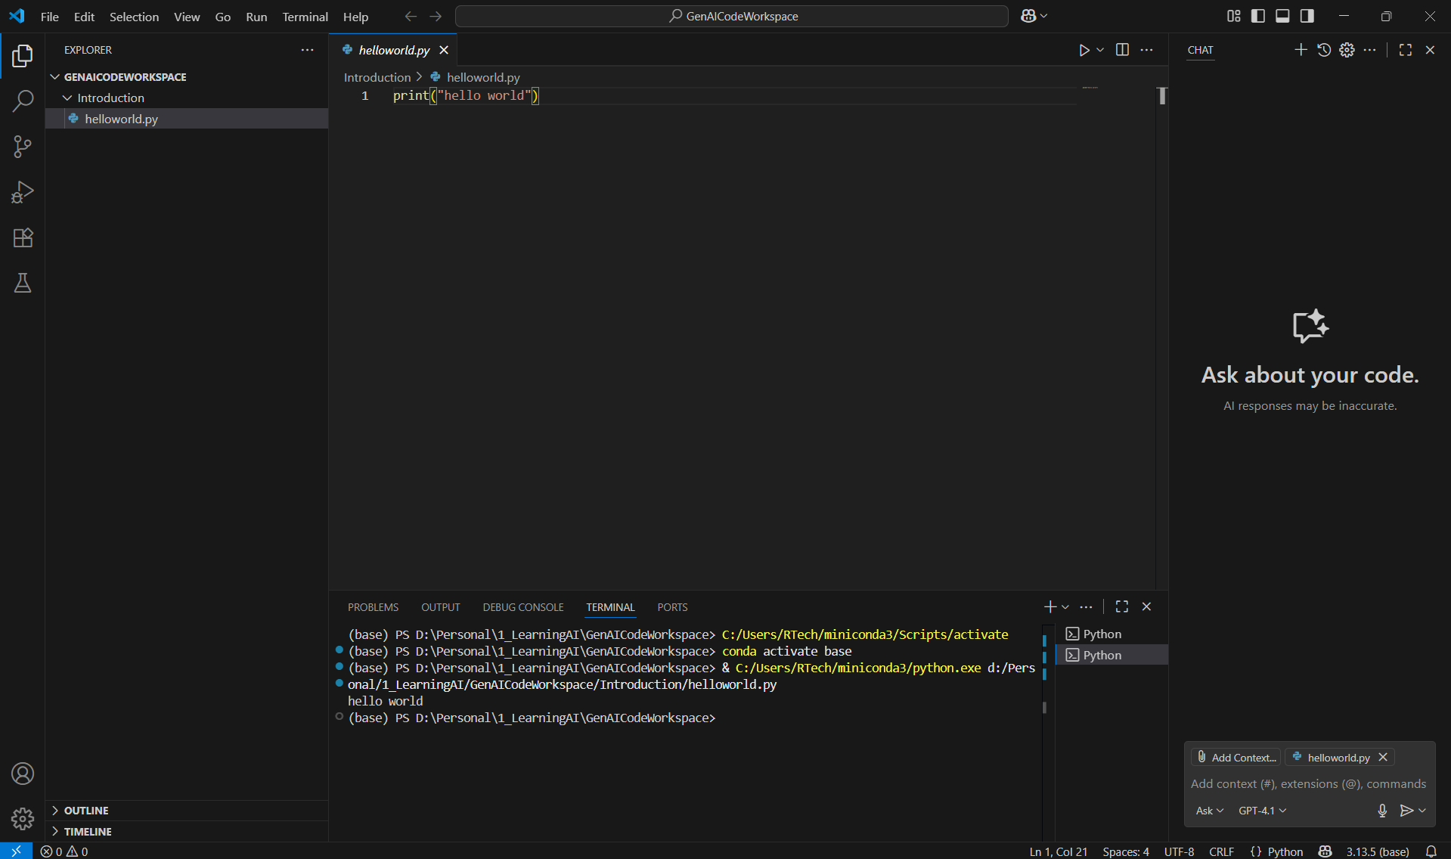
Run this file
Execution is successful. Setup is completed.

Slide 26
Troubleshooting Guide

Slide 27
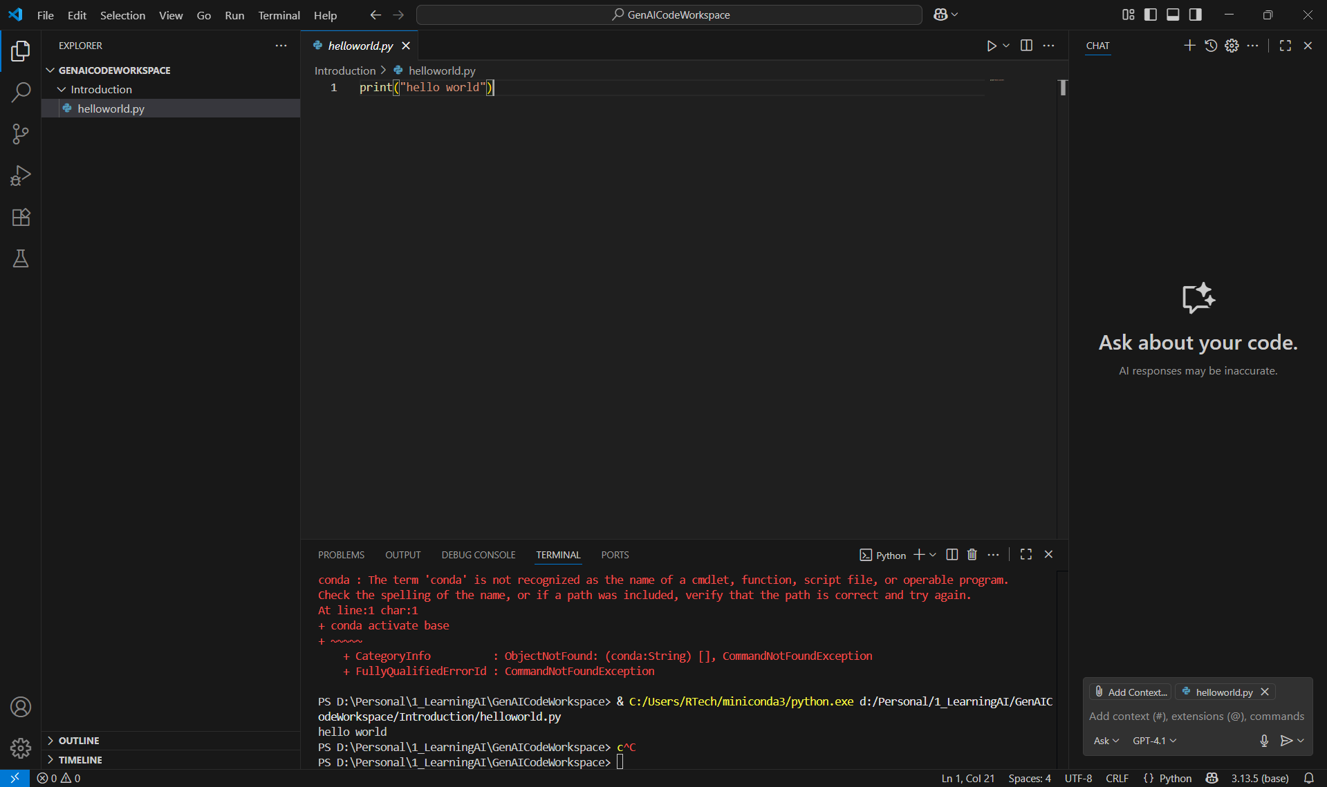
Click here
This happens when the conda executable is not available in your system’s PATH, or conda isn't installed at all. "conda activate base" is a command that tells your system to use the specific Python interpreter and package set that belongs to the "base" Conda environment. The "base" environment is the default root environment created when you install Anaconda or Miniconda. It includes its own Python interpreter and installed libraries. Set the path.

Slide 28
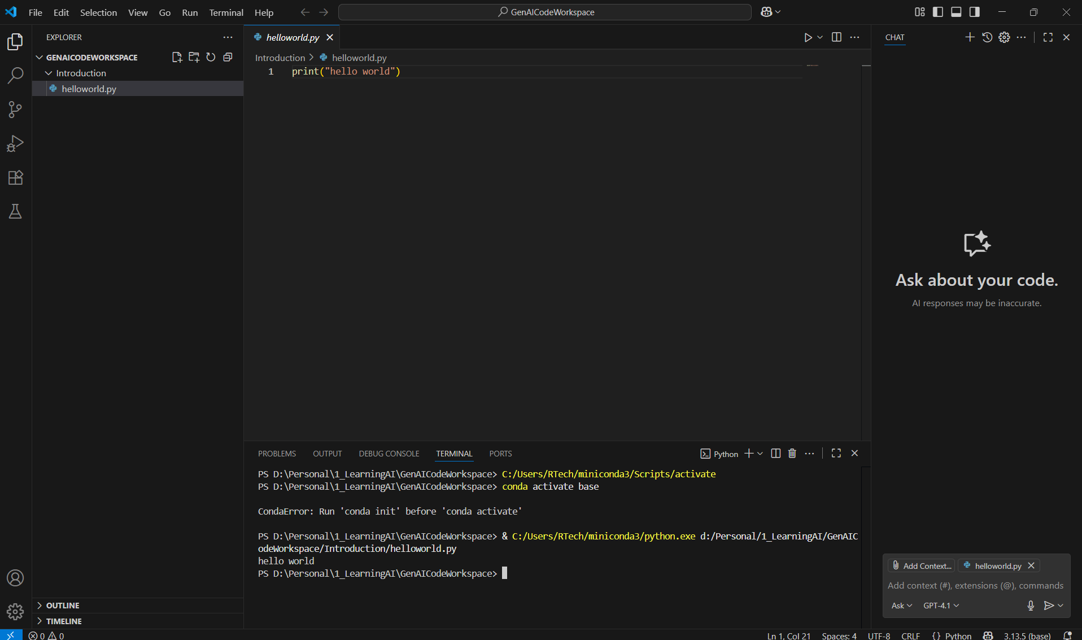
Run this file again
Complete step 7 in this slide.

